Slide 1


Generative AI

Slide 2

Transfer learning

Slide 3
Transfer learning
Transfer learning is a machine learning technique where a model developed for a particular task is reused as the starting point for a model on a second task.
This approach is particularly useful when the second task has limited data available, as it allows the model to leverage the knowledge gained from the first task, which typically has a larger dataset.

Slide 4
Transfer learning
Transfer learning involves taking a pre-trained model (usually trained on a large dataset) and fine-tuning it on a smaller, task-specific dataset.
This can significantly reduce the time and resources needed to train a model from scratch and can lead to better performance, especially in scenarios where data is scarce.
Transfer learning is commonly used in various applications, such as natural language processing (NLP) and computer vision, where models like BERT or ResNet are pre-trained on large datasets and then adapted for specific tasks like sentiment analysis or image classification.

Slide 5
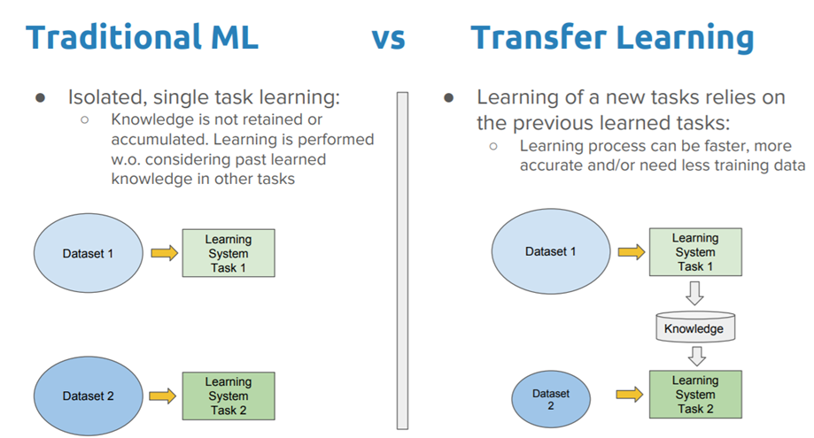
Traditional ML vs transfer learning

Slide 6
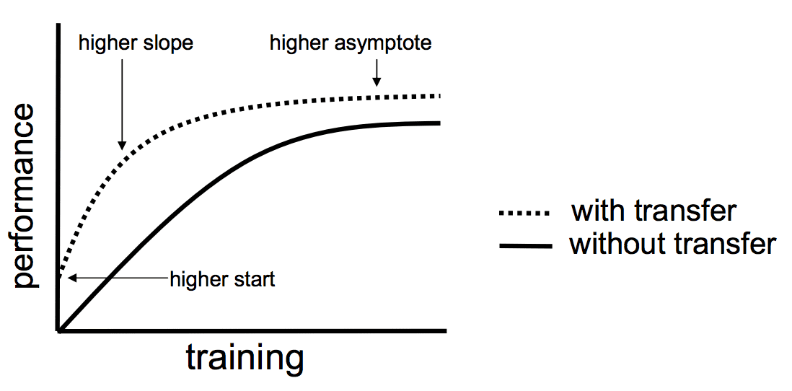
Why transfer learning?

Slide 7
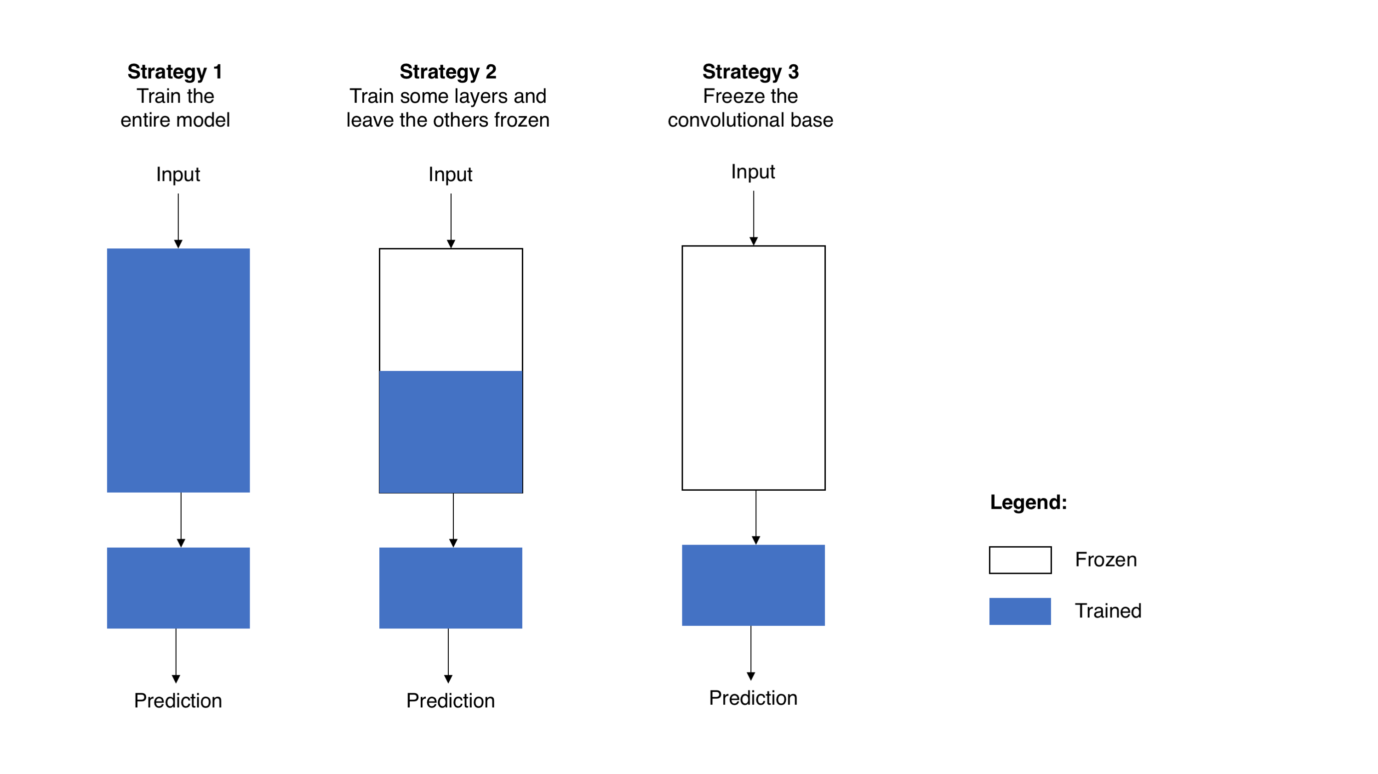
Transfer Learning Strategies in computer vision

Slide 8
three different strategies for training CNNs
Strategy 1: Train the Entire Model
In this approach, all layers of the model are updated (shown in blue).
Useful when you have a large dataset similar to the original training data of the pre-trained model.
Allows the model to learn new features specific to the target data but requires more computational resources.
Strategy 2: Train Some Layers and Freeze Others
Only the final layers are trained (blue), while the earlier layers remain frozen (white).
Effective if the dataset is small or somewhat different from the original dataset.
Reduces computation by not updating all layers, allowing the model to retain lower-level features while adapting higher-level ones.
Strategy 3: Freeze the Convolutional Base
The entire base of the model is frozen, with only the final layer (output layer) trained.
Best when you have a very small dataset or need to transfer the features without altering the main learned representations.
Significantly reduces computation and prevents overfitting, as only the classifier head is trained.

Slide 9

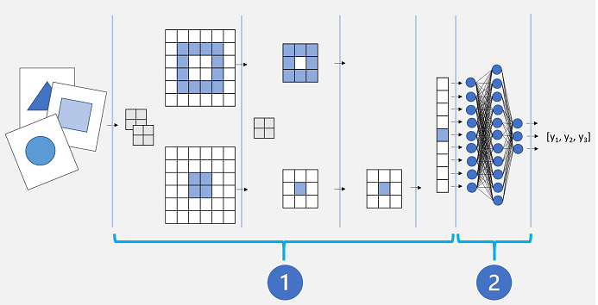
Transfer Learning

Slide 10
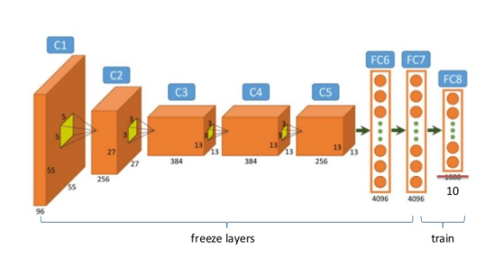
Frozen and trainable layers

Slide 11
Transfer Learning in NLP
Transfer learning strategies for NLP involve similar principles as in computer vision but are tailored to the unique architecture of NLP models, especially large language models.
Fine-Tuning the Entire Model
Description: This approach involves training all layers of a pre-trained NLP model on your specific target dataset.
Use Case: Useful when you have a large labeled dataset that's domain-specific, such as legal or medical texts.
Advantages:
Model adapts fully to the nuances of the target data.
Drawbacks:
Computationally expensive, especially with large models like BERT or GPT-based architectures.
Higher risk of overfitting if the dataset is small.

Slide 12
Transfer Learning in NLP
Fine-Tuning Only Higher Layers
Description: Here, the lower layers (closer to input) remain frozen, while only the higher layers are fine-tuned.
Use Case: Ideal when the target dataset is small and there are specific patterns or terms in the target domain that are different from general language use (e.g., technical or industry-specific vocabulary).
Advantages:
Retains core language understanding in lower layers while allowing model customization for the domain in upper layers.
Less computationally intensive than full model fine-tuning.
Drawbacks: Limited adaptability, as lower-level language features (like morphology or syntax) remain unchanged.

Slide 13
Transfer Learning in NLP
Adapter Layers (Parameter-Efficient Fine-Tuning)
Description: Adapter layers, which are additional small neural networks, are inserted between existing layers of a pre-trained model and are the only ones fine-tuned, while the original model layers are frozen.
Use Case: Popular for multilingual or multi-domain models where multiple tasks or languages need to be supported without retraining the entire model.
Advantages:
Significantly reduces memory and computational requirements.
Allows quick adaptation to multiple domains by simply switching adapters.
Drawbacks: May not achieve the same level of fine-grained domain adaptation as full fine-tuning.

Slide 14
Transfer Learning in NLP
Prompt Tuning
Description: Instead of fine-tuning the model parameters, the model is prompted with task-specific text patterns. This involves learning a set of soft prompts or embeddings that guide the model's behavior for a specific task.
Use Case: Best suited for very large models (like GPT-3 and GPT-4) where direct parameter tuning is impractical, or when working with few-shot or zero-shot learning scenarios.
Advantages:
Efficient for large-scale language models.
Avoids altering model parameters, maintaining generalizability across tasks.
Drawbacks: Relies heavily on prompt engineering, which can be challenging to optimize.

Slide 15
Transfer Learning in NLP
Embedding Layer Fine-Tuning
Description: Only the embedding layer (first layer that maps input words to dense vectors) is trained, while other layers are frozen.
Use Case: Suitable for tasks where the vocabulary or semantic meanings are different from those in the pre-trained model (e.g., medical jargon, slang, or industry-specific terms).
Advantages:
Efficient and lightweight, focusing solely on improving vocabulary understanding.
Drawbacks: Limited effect on overall model behavior, as deeper model semantics remain unchanged.

Slide 16
Transfer Learning in NLP
Distillation-Based Fine-Tuning
Description: Involves training a smaller "student" model to mimic a larger "teacher" model's behavior on a specific task, usually by using the teacher's predictions as soft labels.
Use Case: Useful when you need a smaller, faster model for deployment without losing too much performance.
Advantages:
Greatly reduces model size and inference time.
Maintains most of the teacher model’s performance.
Drawbacks: Requires an additional training step and can be difficult to match the teacher’s accuracy on complex tasks.

Slide 17
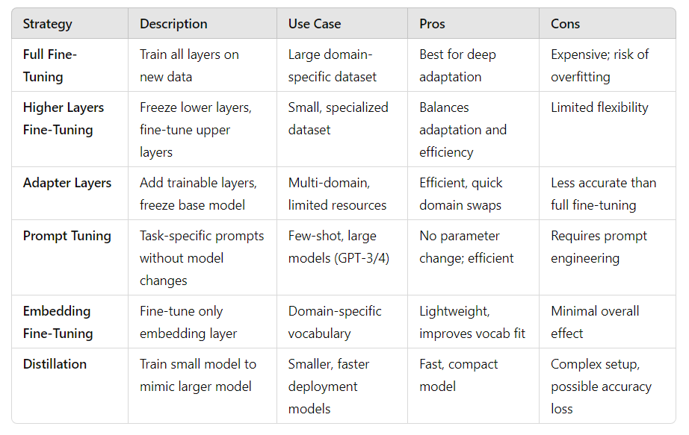
Summary
Strategy | Description | Use Case | Pros | Cons
Full Fine-Tuning | Train all layers on new data | Large domain-specific dataset | Best for deep adaptation | Expensive; risk of overfitting
Higher Layers Fine-Tuning | Freeze lower layers, fine-tune upper layers | Small, specialized dataset | Balances adaptation and efficiency | Limited flexibility
Prompt Tuning | Task-specific prompts without model changes | Few-shot, large models (GPT-3/4) | No parameter change; efficient | Requires prompt engineering
Embedding Fine-Tuning | Fine-tune only embedding layer | Domain-specific vocabulary | Lightweight, improves vocab fit | Minimal overall effect
Distillation | Train small model to mimic larger model | Smaller, faster deployment models | Fast, compact model | Complex setup, possible accuracy loss

Slide 18
Choosing the Right Strategy
Choosing the best strategy depends on:
Data Size: Full fine-tuning requires large datasets; smaller datasets work better with partial or adapter-based methods.
Computational Constraints: Adapters and prompt tuning are less resource-intensive.
Domain Specificity: If the target domain is highly specialized, strategies that allow some adaptation of word embeddings or higher layers (like fine-tuning the last few layers) may work best.

Slide 19
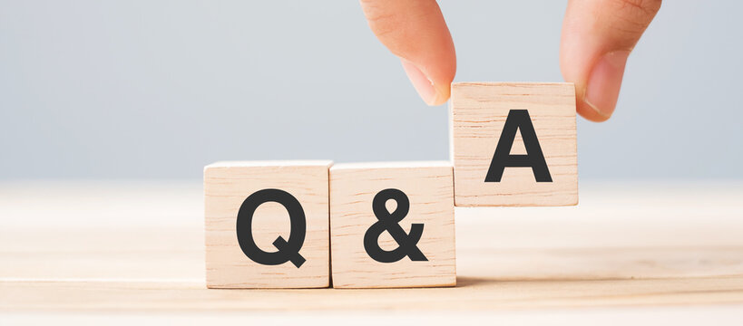
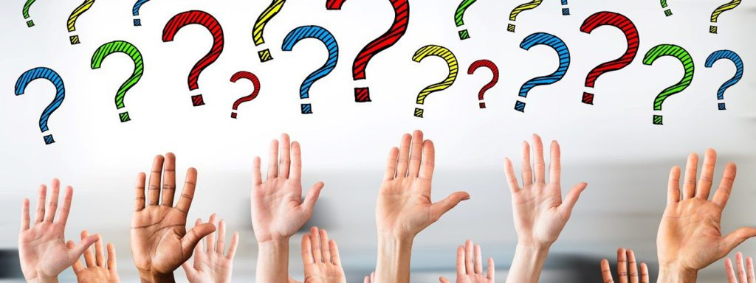
Q&A

